Slide 1



Slide 2




Slide 3
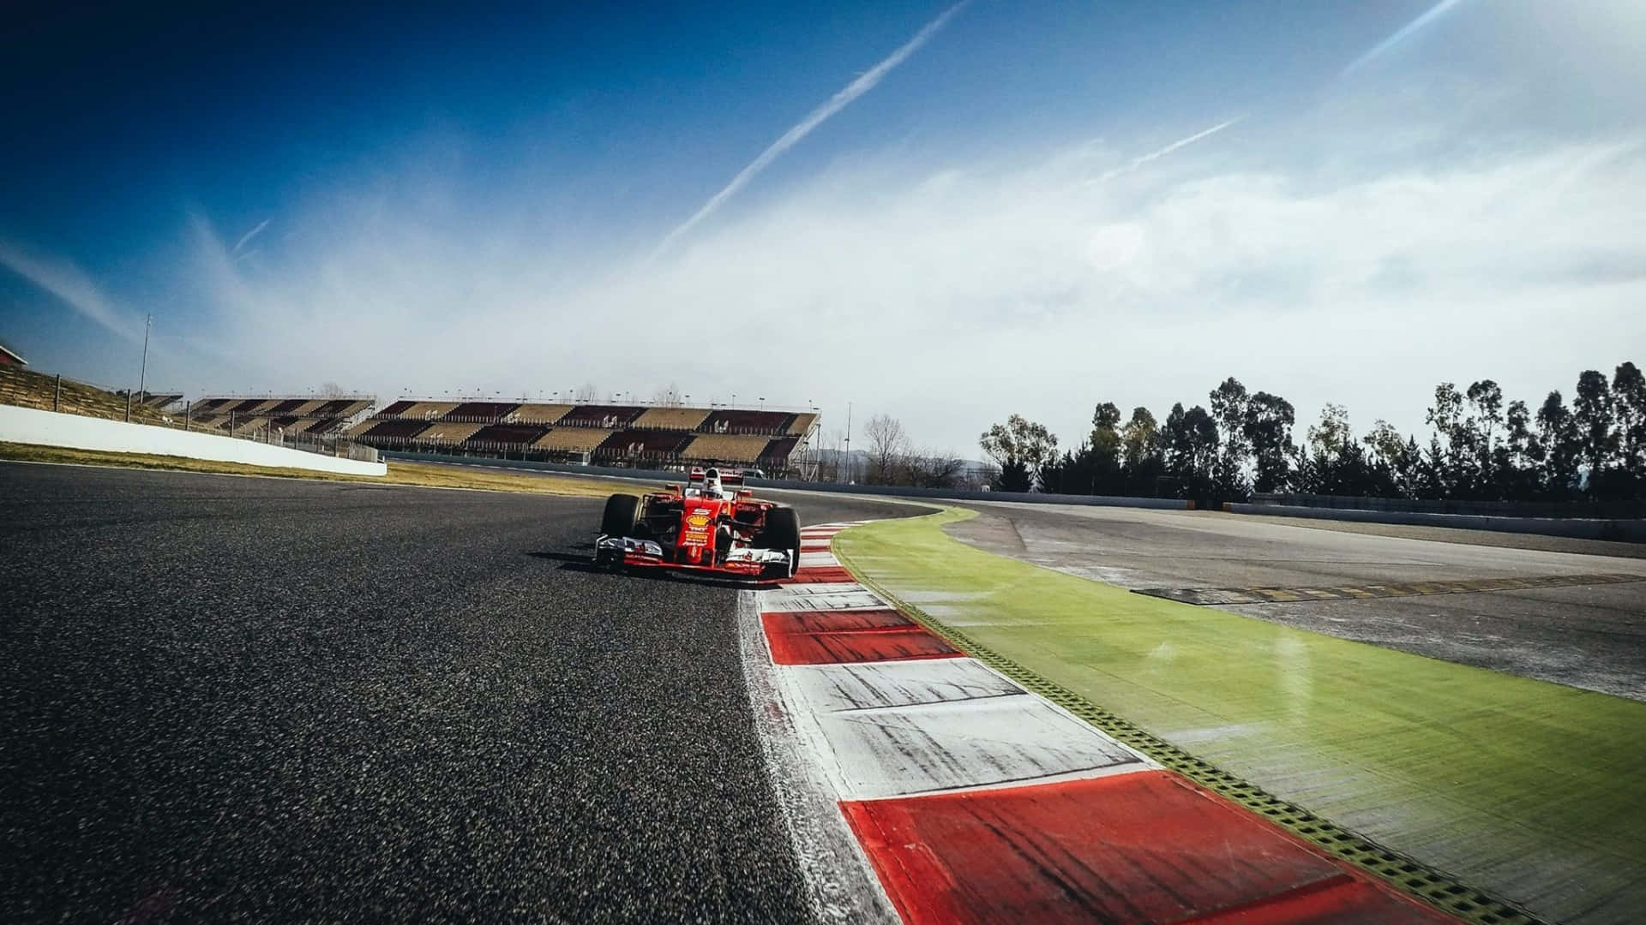


WEBSITES SCRAPED

Slide 4
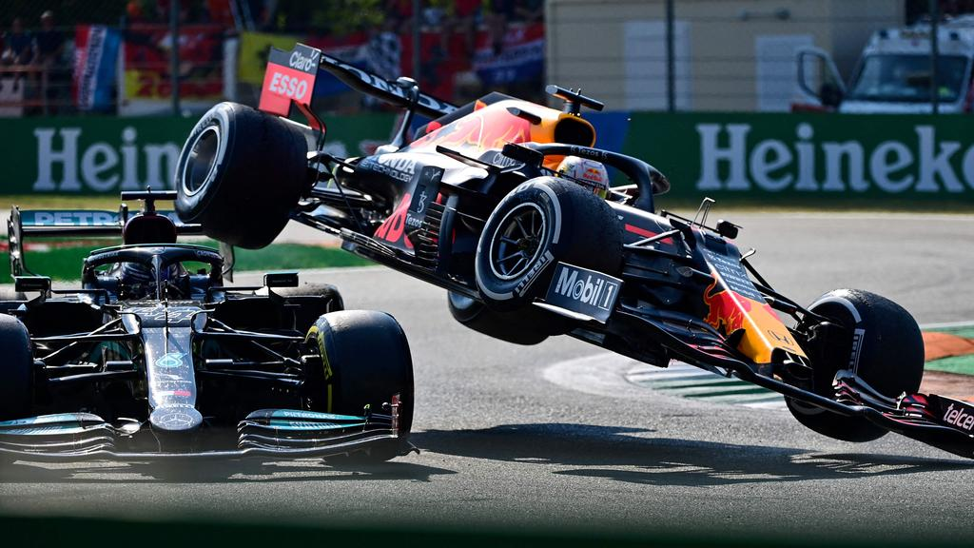

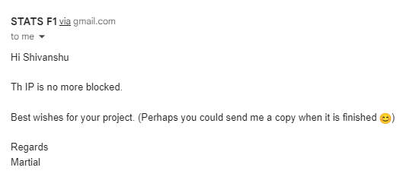
WASTED

Slide 5
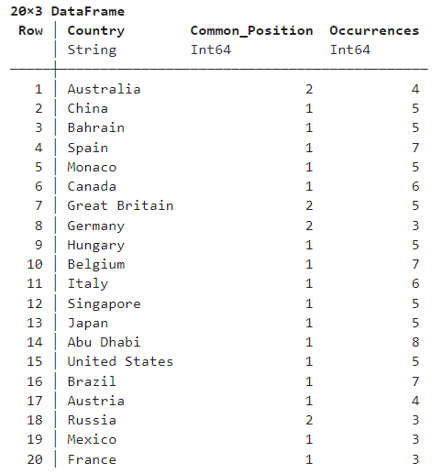
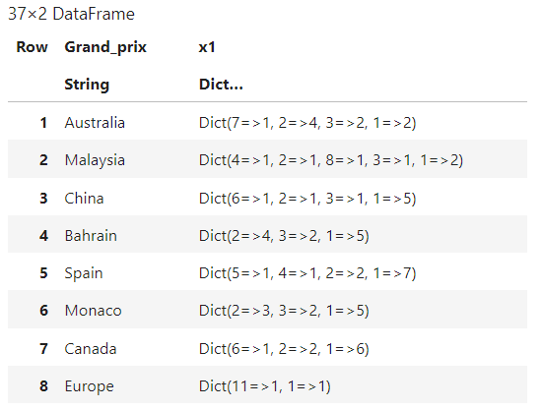
Grid Advantage Analysis

Slide 6

Final Product – Web App Screenshots https://feed-for-speed.shinyapps.io/index

Slide 7

Notes:
Home Page – Landing page for feed for speed web application. Having 6 tabs that persists across the application; Home Page, Select Race, Live Racing, Overlapping Zone, Race Hotness Meter, Insights
Fig1. Home Page for feed for speed.

Slide 8
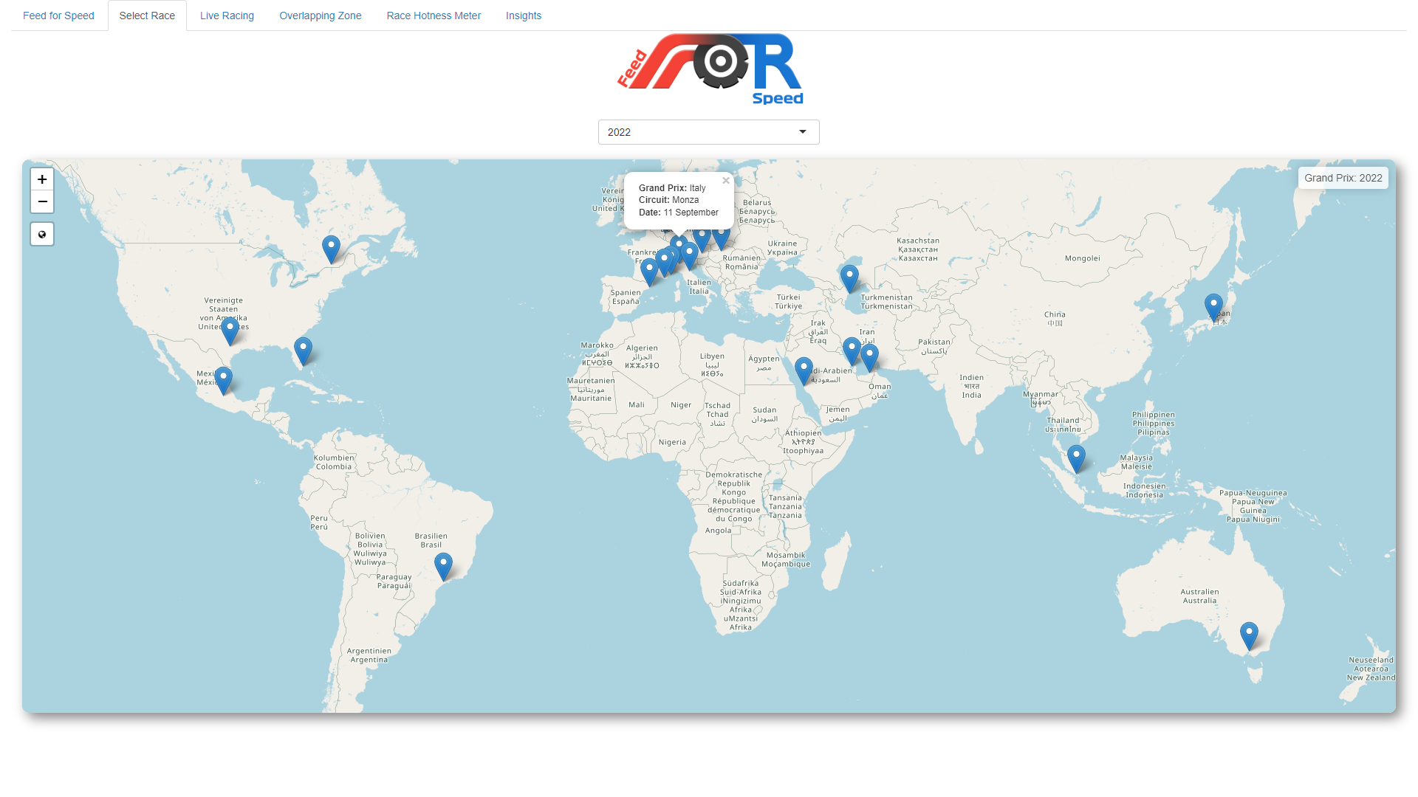
Notes:
2. Map View – Provides a map year wise and plots markers for every race for the respective year.
Maps are provided by Open Street Maps implemented using leaflet library.
Fig 2. Map for year 2022 with Monza, Italy Grand Prix selected.

Slide 9
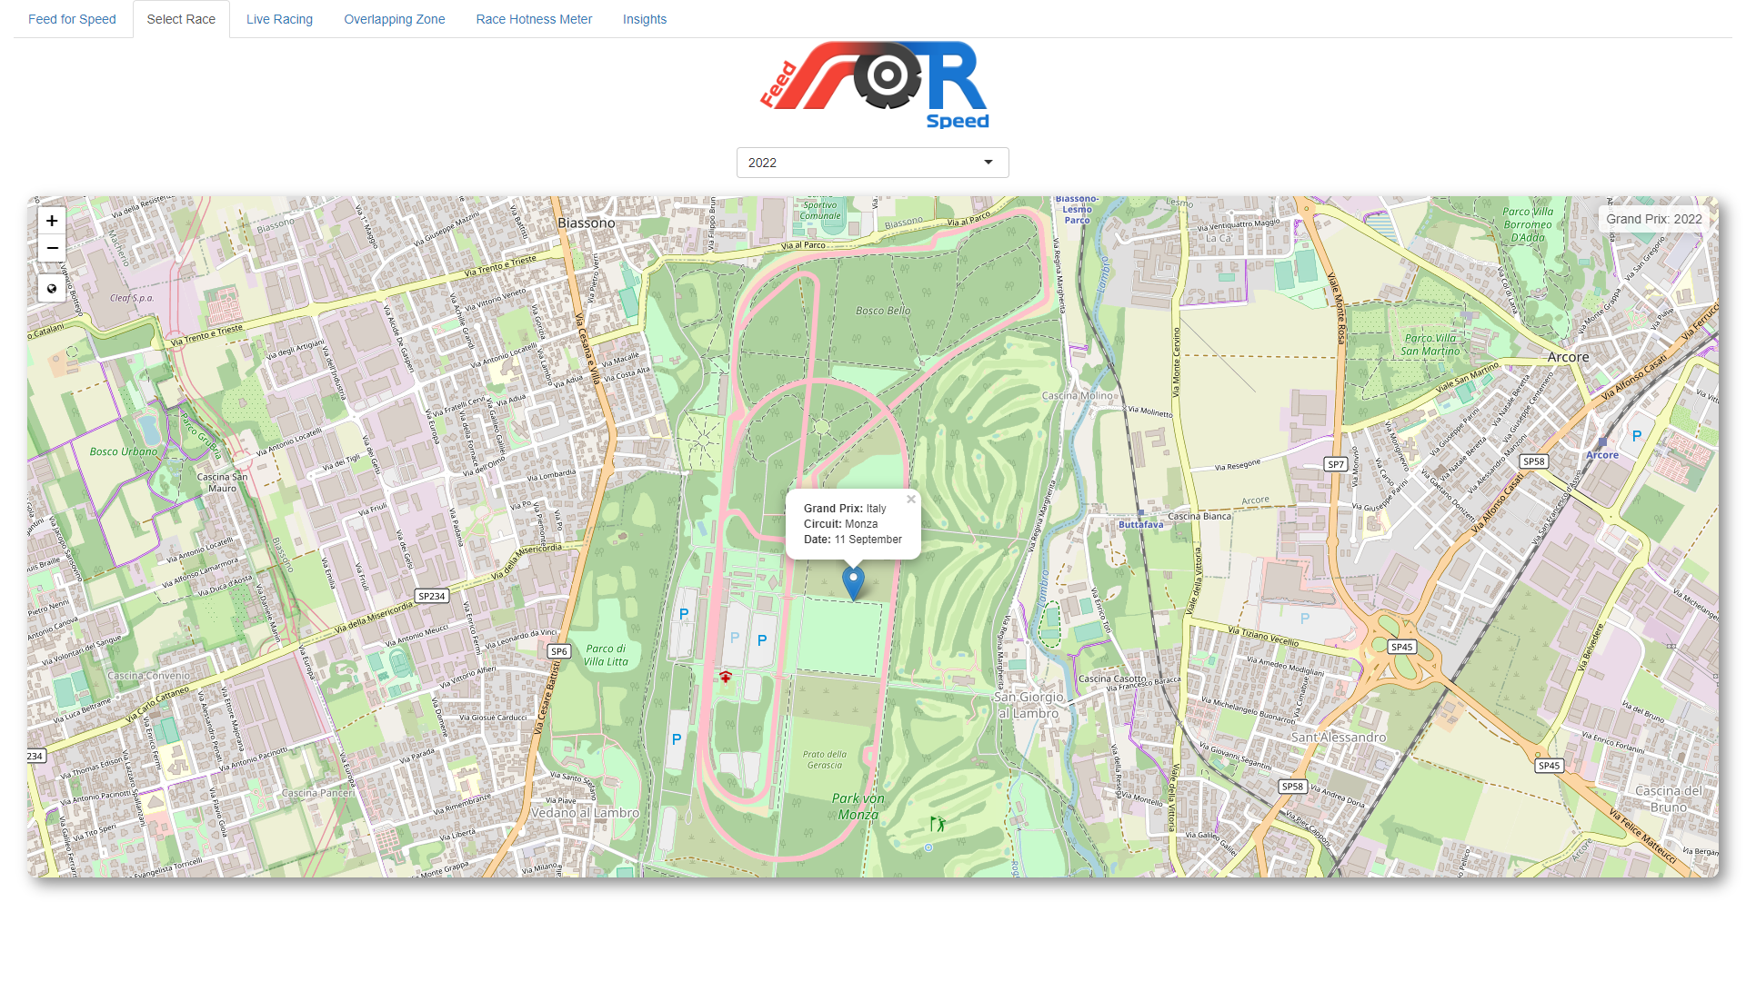
Notes:
The maps are interactive and can be zoomed in or out based on user selection.
Fig 3. Monza, Italy circuit can be seen after zooming in.

Slide 10
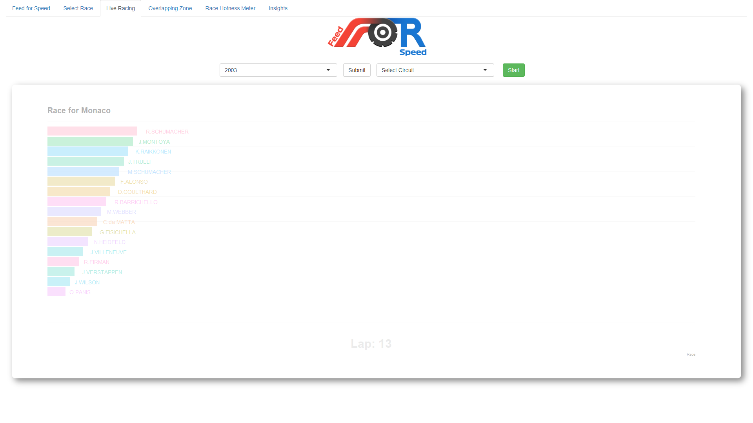
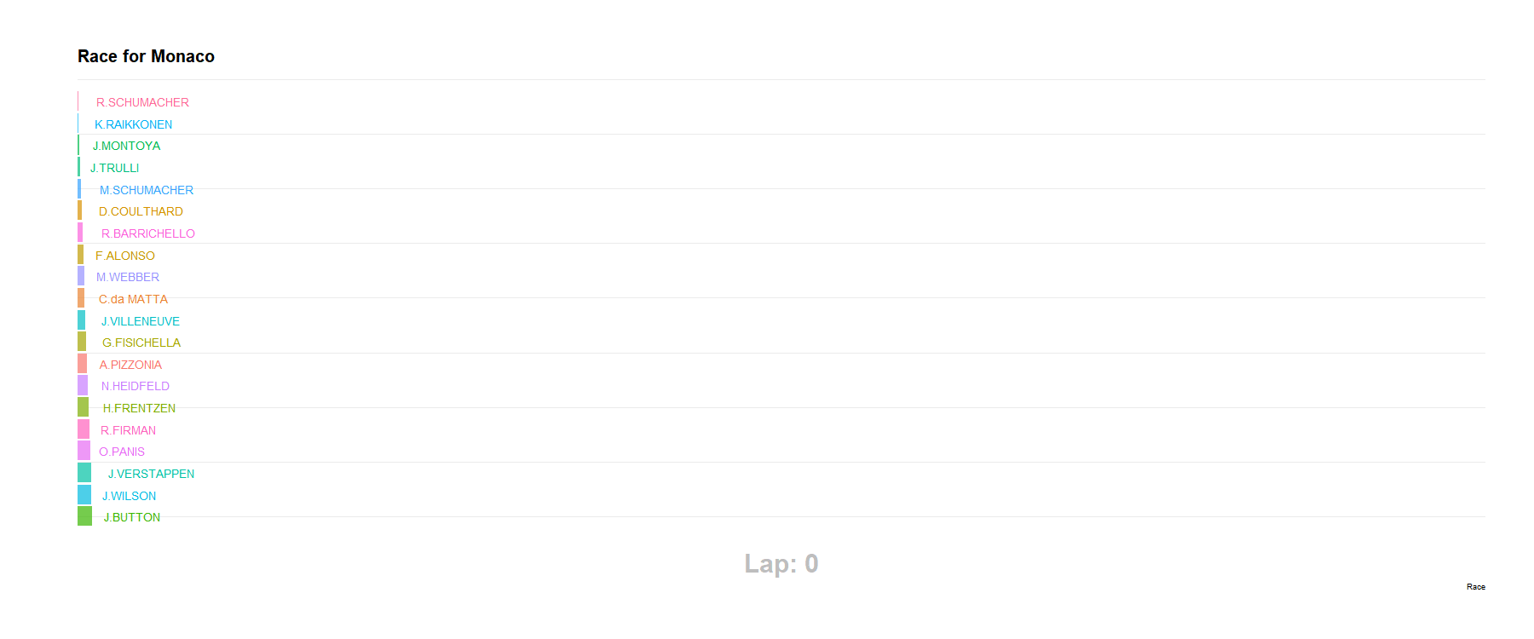
Notes:
Live Racing Tab – Not your regular graph, visualise each race from 1950 to 2023 with a help of racing bar chart. Animated Bar Chart that shows overlapping across laps like a real race.
Fig. 4. Racing Bar Chart for Monaco, 2003

Slide 11
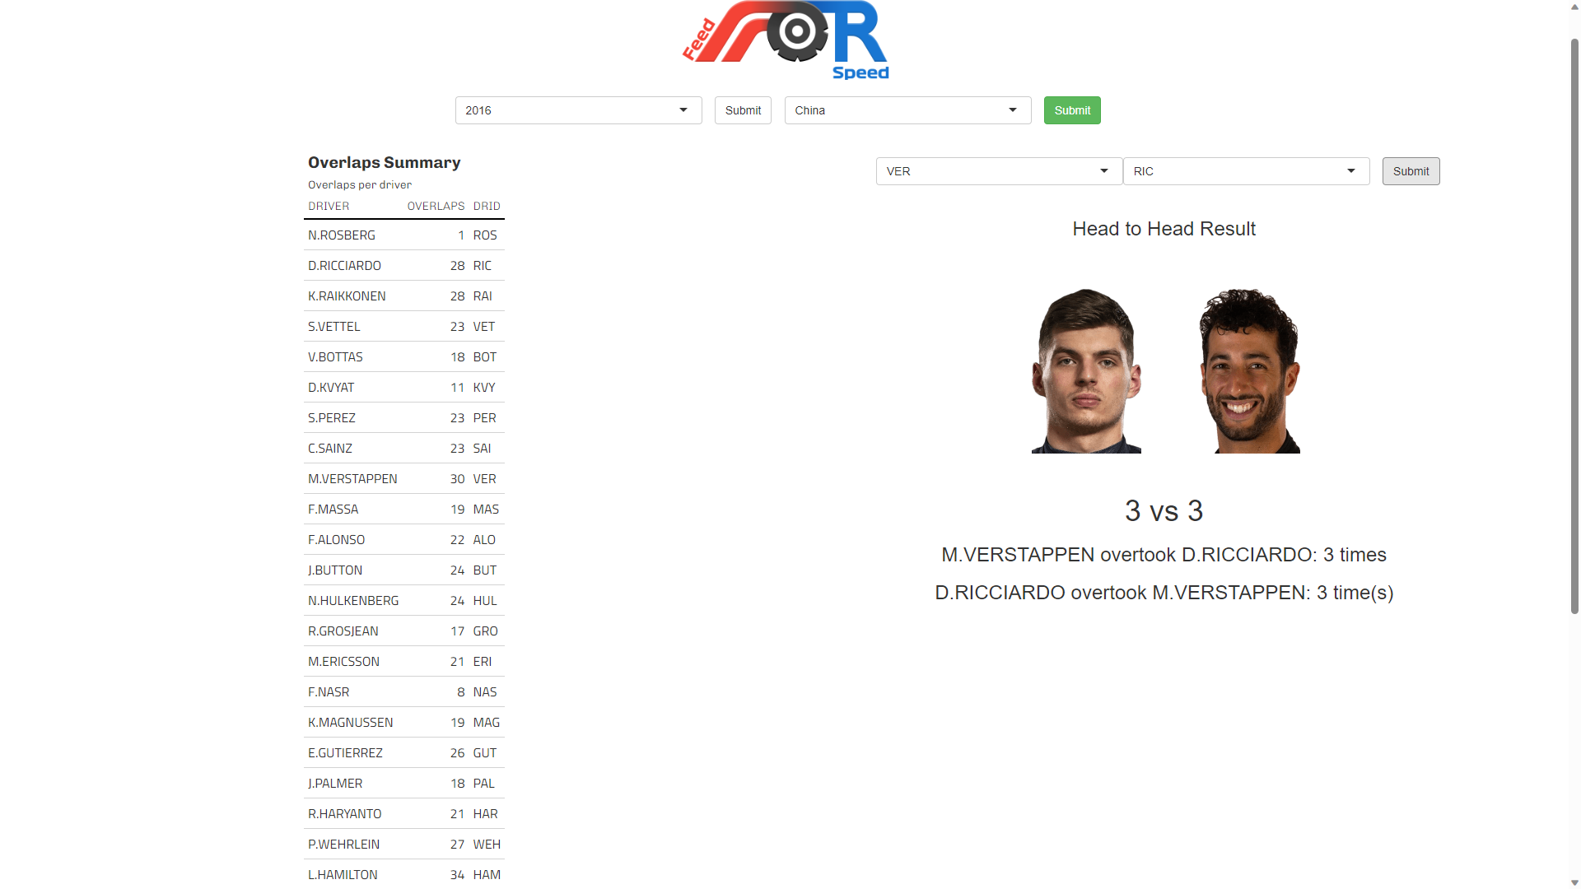
Notes:
Overlapping Zone – After selecting and race for the specific year, it will greet you will Overlaps summary table for the race that shows total overlaps done by each driver in the race. On right there are 3 drop downs that will get auto populated with driver’s names from the selected race. After selecting 2 drivers we can see their head to head overlaps for that race. (Driver’s photos are also scraped on demand for the drivers selected on the right drop downs).
Fig. 5. Overlaps Summary Table on the left for the race China, 2016 (left) and Head to Head Overlaps of Max Verstappen and Daniel Ricciardo with their photos.

Slide 12
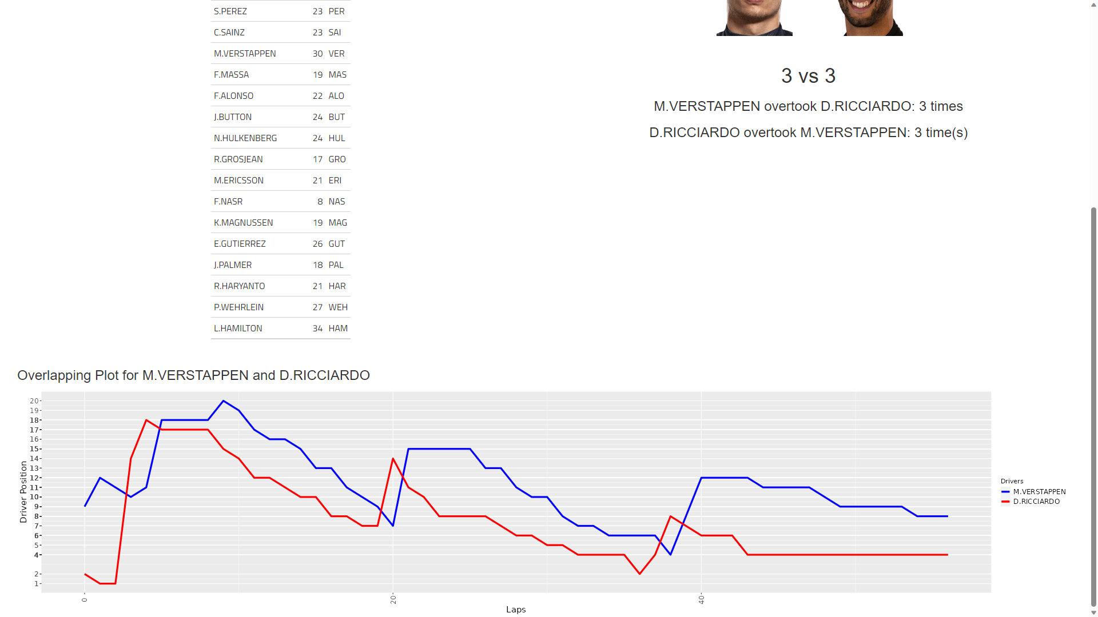
Notes:
Overlapping Zone – The head to head overlaps for the two drivers for the race are also shown graphically using line plot, where Laps are on the X-Axis and Positions are on the Y-Axis and line for each driver.
Fig 6. Overlapping Lap Plot for Max Verstappen and Daniel Ricciardo for the race China, 2016

Slide 13
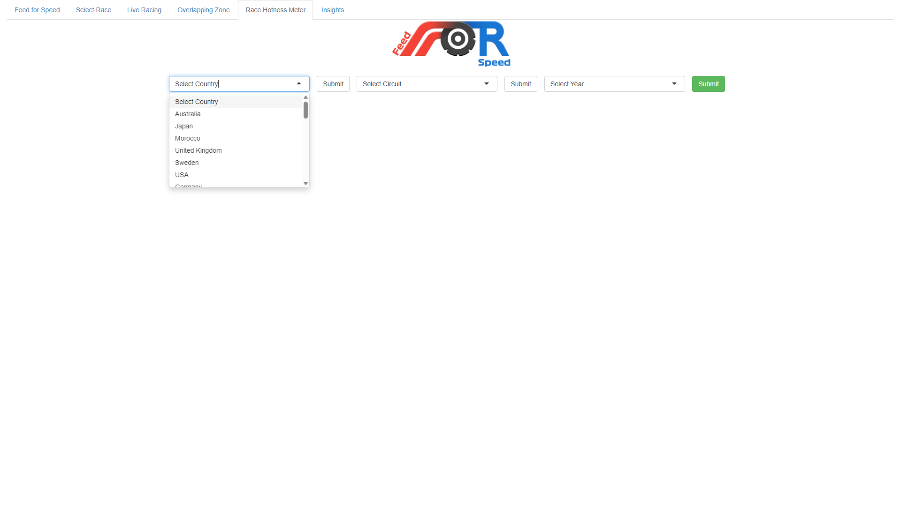
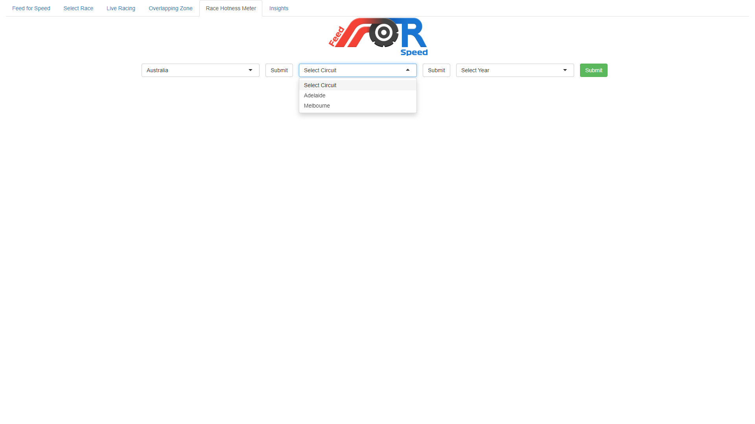
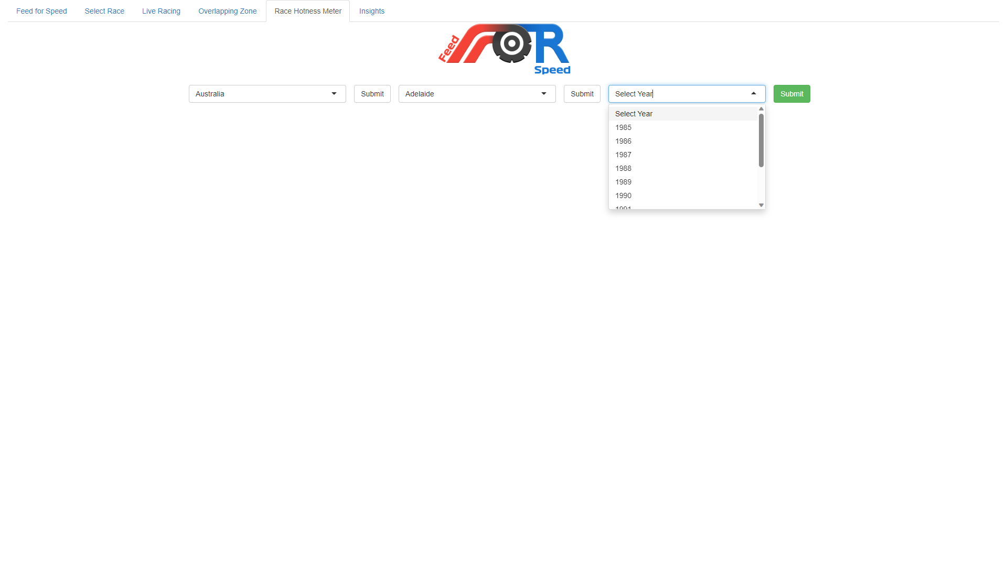
Screenshot 1
Select Country
Screenshot 2
Select Circuit
Screenshot 3
Select Year
Notes:
Race Hotness Meter – Shows a gauge chart (next page) for total overlaps for a specific race for the year. The Country should be selected first (Screenshot 1) , after clicking submit the second drop down will get populated with Circuits for the country (Screenshot 2) select the preferred circuit. After selecting the circuit the year drop down will get populated with the years when the race was organized.

Slide 14
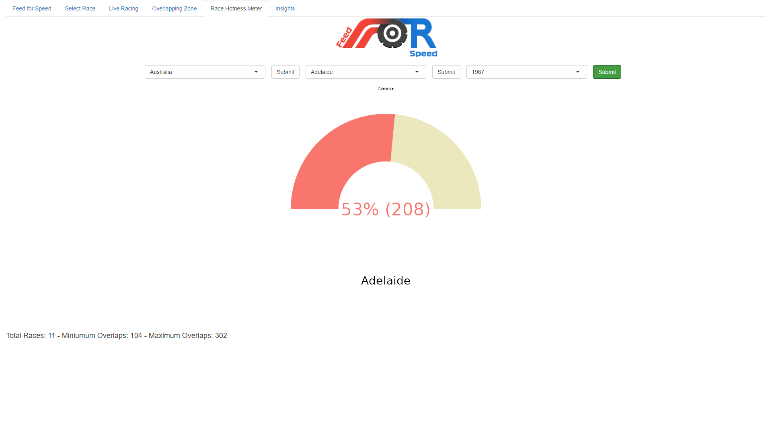
Notes:
Race Hotness Meter – Its shows total number of overlaps for a specific race from 1950 to 2023. Also shows stats for the specific circuit consisting of Total Races, Minimum Overlaps and Maximum Overlaps.
Fig 7. Overlapping Meter (Gauge Chart) for 1987 Race at Adelaide, Australia.

Slide 15
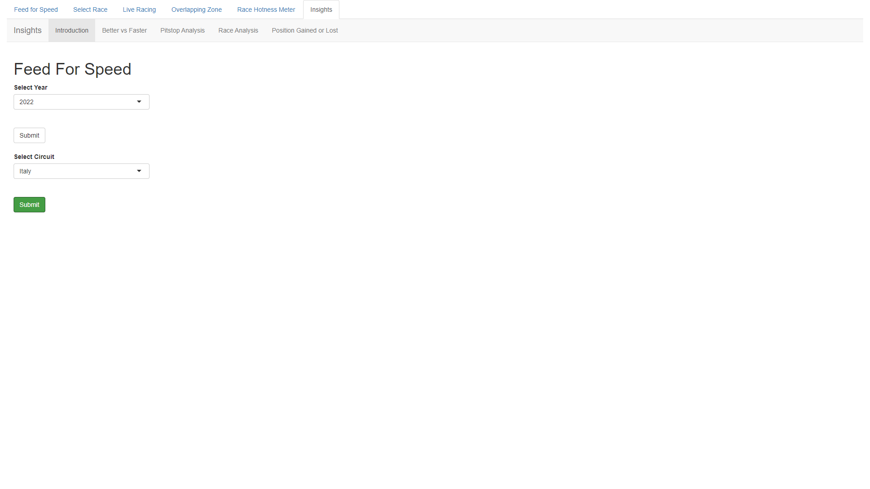
Notes:
Insights Tab – Helps you to analyse each race individually with various tables and relations.
Fig 8. Insights Tab where Year and Circuit are selected that are to be analysed. Italy, 2022 in this case.

Slide 16
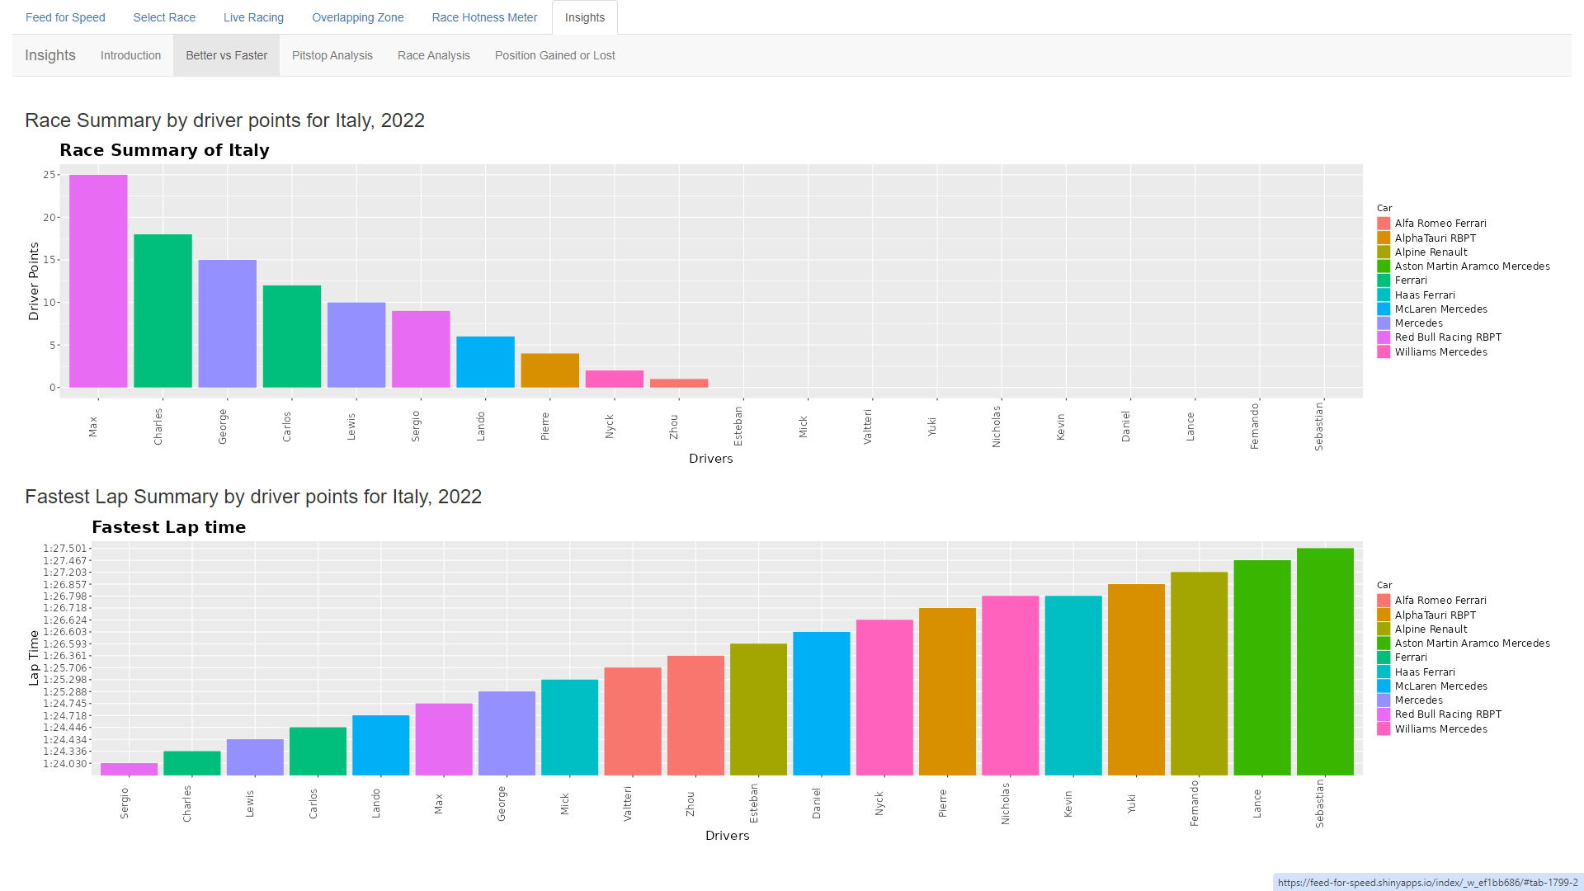
Notes:
Insights Tab – Better vs Faster Tab – Shows two bar charts, first for ‘Race Summary’ that shows total points earned by each driver for the race with Drivers on X-Axis and Driver Points on Y-Axis. Second for, Fastest Lap Summary that shows fastest lap by each driver for the race with Drivers Name on X-Axis and Time on Y-Axis.
Fig. 9. Race Summary Chart and Fastest Lap Summary Chart for Italy, 2022

Slide 17
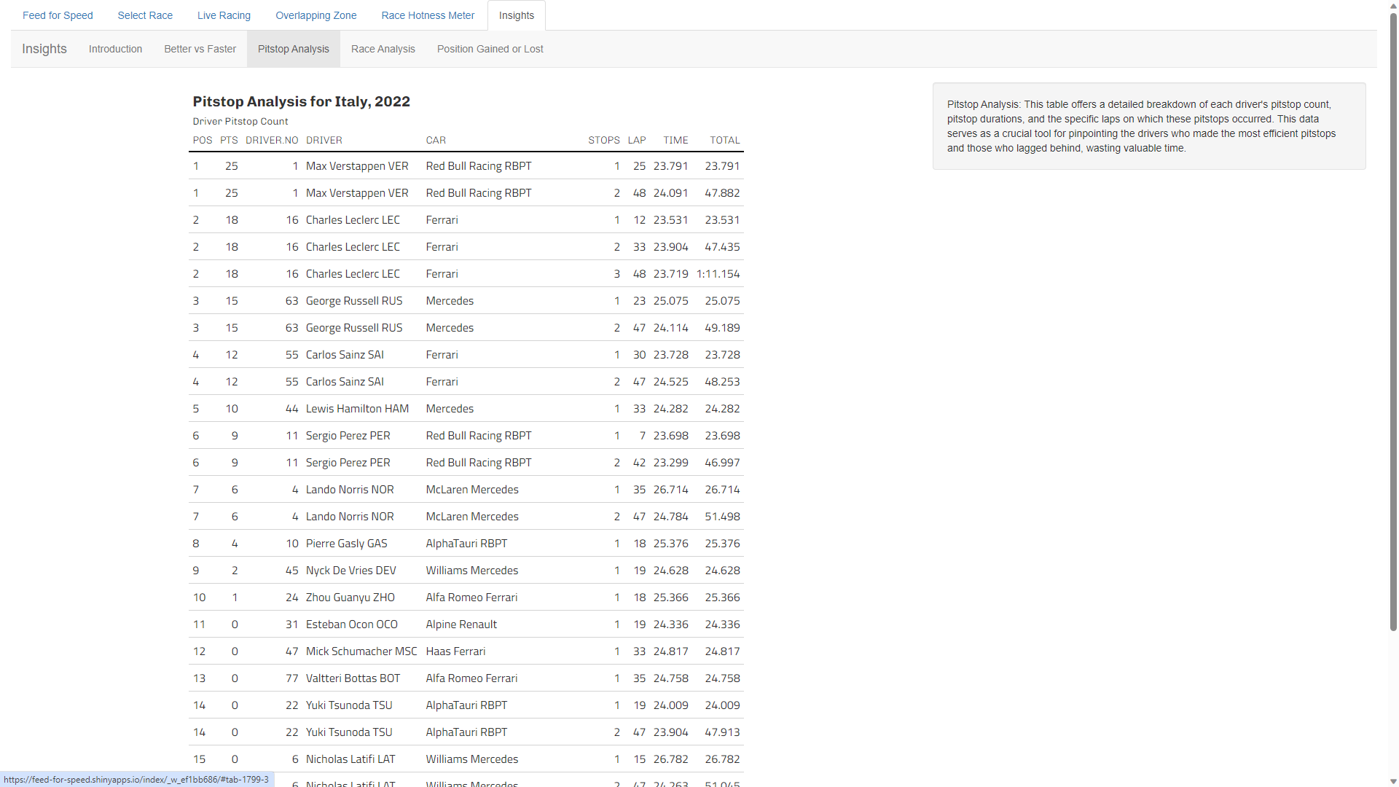
Notes:
Insights Tab – Pitstop Analysis – Table for pitstop analysis. Shows a relation between Race Position and Pitstops Details.
Fig. 10. Pitstops Analysis Table for Italy, 2022

Slide 18
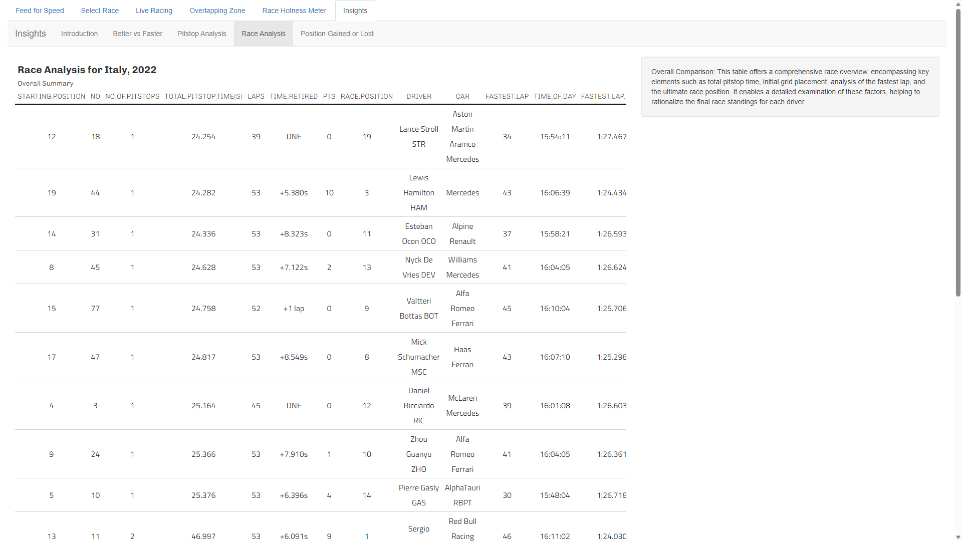
Notes:
Insights - Race Analysis – In-depth Overall Race Analysis
Fig. 11. In-Depth race analysis for Italy, 2022

Slide 19
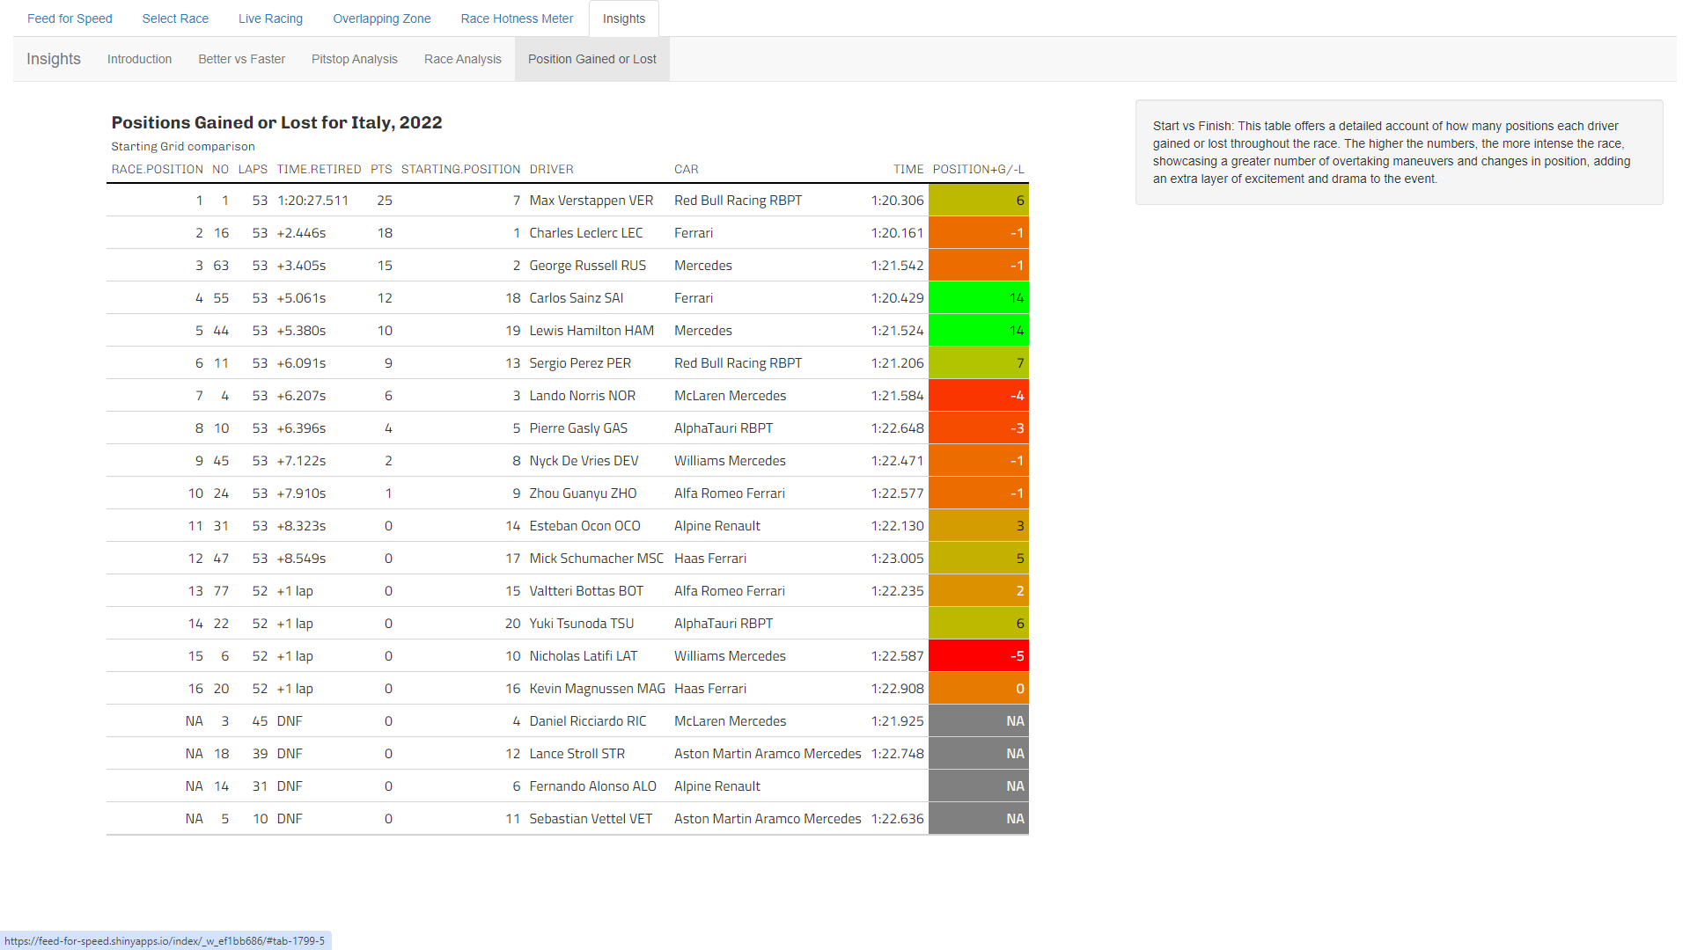
Notes:
Insights – Position Gained or Lost – Table for comparison of pole and final positions to calculate the number of positions gained or lost.
Fig. 12. Positions Gained or Lost for Italy, 2022 Race.

Slide 20
Group Members
Naman Rastogi – nra99
Shivanshu Tandon – sta219
Ans Joy – ajo191
Ashly Thomas – ath152
Notes:
Group Members

